Slide 1



EMO TAGGER
Final Project Presentation
1st Semester
Selin Uzunoğlu
Serhat Yıldız
Hamza Basil Waheed
Samed Tuğkan Çinko
Kübra Begüm Üleş
Taha Emre KARATAŞ
A COMMUNITY DRIVEN EMOTION ANNOTATION TOOL
Advisor : Abdül Kadir GÖRÜR

Slide 2




Content of the Presentation
Introduction
Literature Review
Strategy
Purpose
Vision
Use Cases
User Interface
WHAT WILL WE DO IN THE 2ND TERM

Slide 3

Under our instructor's guidance, we decided to focus on the "EmoTagger" project. The reason we chose this project is its innovative and creative approach to deeply exploring the impact of music on emotions. EmoTagger provides a platform that allows users to label the songs they listen to with emotional responses. Through this platform, we aim to build an extensive dataset with over 10,000 emotionally tagged music files.

Slide 4

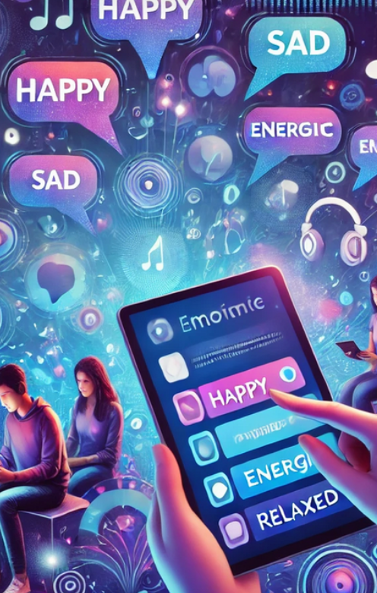


What is EMO TAGGER ?
Emo Tagger is a community-driven emotion tagging platform developed to explore the impact of music on human emotions. Users contribute by tagging the songs they listen to with emotional responses (e.g., happy, sad, energetic). With gamification features, it encourages user engagement and aims to build a rich dataset containing emotional tags for over 10,000 songs.

Slide 5
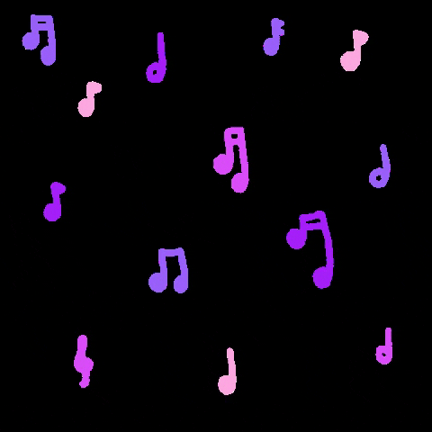
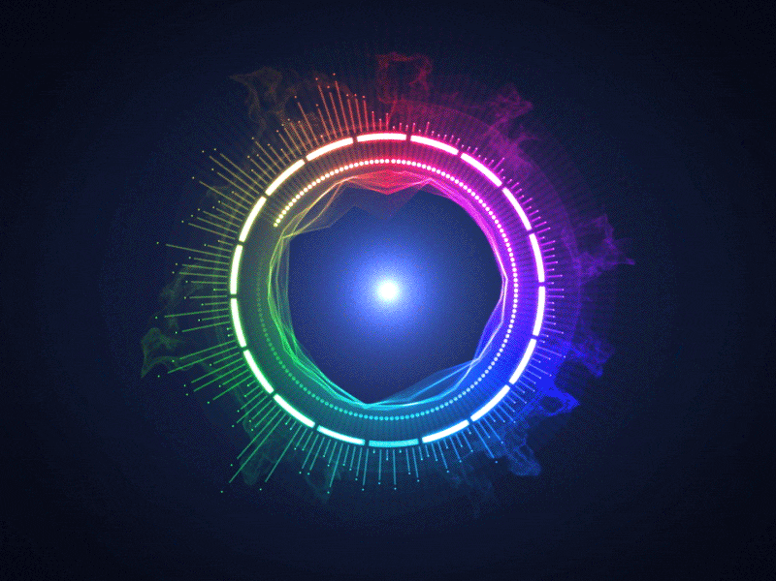



1.Crowdsourcing and Data Annotation in Music Labeling
2.How Crowdsourcing Works for Music Labeling
3.Data Annotation in Music
4.Music and Emotion Analysis
5.Practical Applications and Benefits of Crowdsourcing for Our Project
6.Gamification for Enhanced Engagement

Slide 6
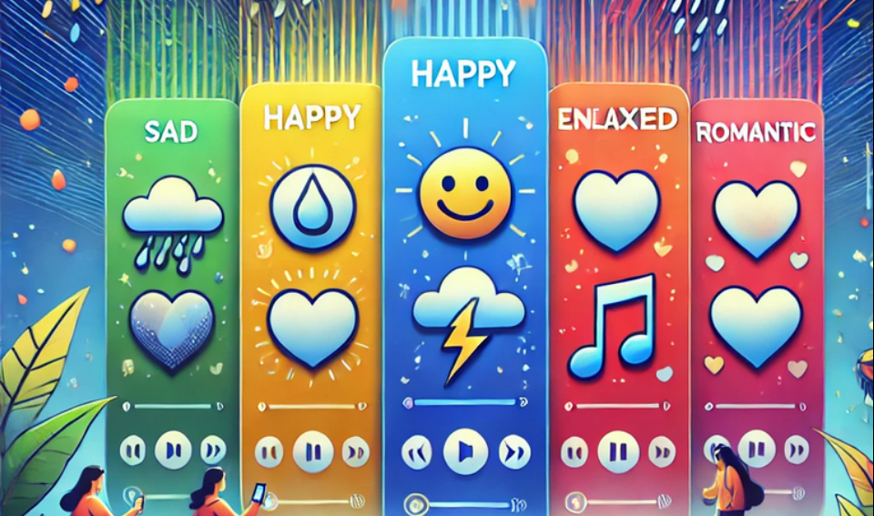
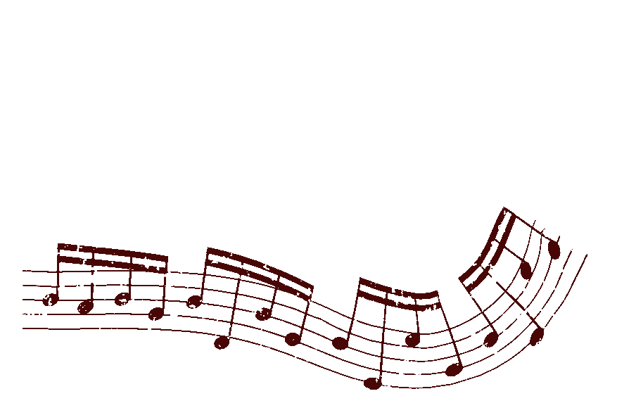
The core strategy of the EmoTagger project is to utilize the crowdsourcing method, enabling users to tag music files based on their emotional responses. This approach facilitates the collection of diverse emotional interpretations through contributions from a broad user base, thereby creating a rich and culturally deep dataset.
Crowdsourcing relies on users collectively providing data, offering significant advantages in terms of cost-efficiency and speed. The platform aims to boost continuous participation by encouraging users with gamification elements.

Slide 7

Music is the most beautiful experience we can have within the realm of mystery.
“
”
Albert Einstein

Slide 8



Future Benefits and Importance of Crowdsourcing
Advancements in Music Therapy and Psychology The comprehensive emotion-labeled dataset will support research in music therapy and psychology, enabling deeper exploration of how specific music genres reduce stress, boost motivation, or promote emotional balance.
Personalized Music Recommendation Systems By analyzing users' emotion-based reactions, more accurate and personalized music recommendation systems can be developed, enhancing user experience and offering innovative solutions for the music industry.
Training Data for AI and Data Science The diverse dataset collected through crowdsourcing will serve as valuable training material for AI and machine learning models, enabling more advanced emotional analysis and a deeper understanding of the connection between music and emotions.

Slide 9

Vision "To revolutionize the way people connect with music by creating a dynamic platform that bridges emotional expression and musical discovery, fostering deeper understanding and appreciation of the emotional impact of music."

Slide 10

Purpose
The aim of our project is to act as a third-party observer by utilizing the data provided by individuals through crowdsourcing, where they label various pieces of music based on emotions. Our goal is to process and interpret this data effectively.

Slide 11


Technology Stack and Development Environment
ASP.NET Core : ASP.NET Core was chosen for backend development due to its advantages in performance, flexibility, and security. Being a cross-platform framework, it ensures compatibility with both current and future system requirements.
SQL Database : SQL was selected for data management and storage.
Data Layer :The data layer was designed as a critical component that manages communication between the application and the database. Its implementation enhances the modularity and reusability of the code, making future updates easier.

Slide 12
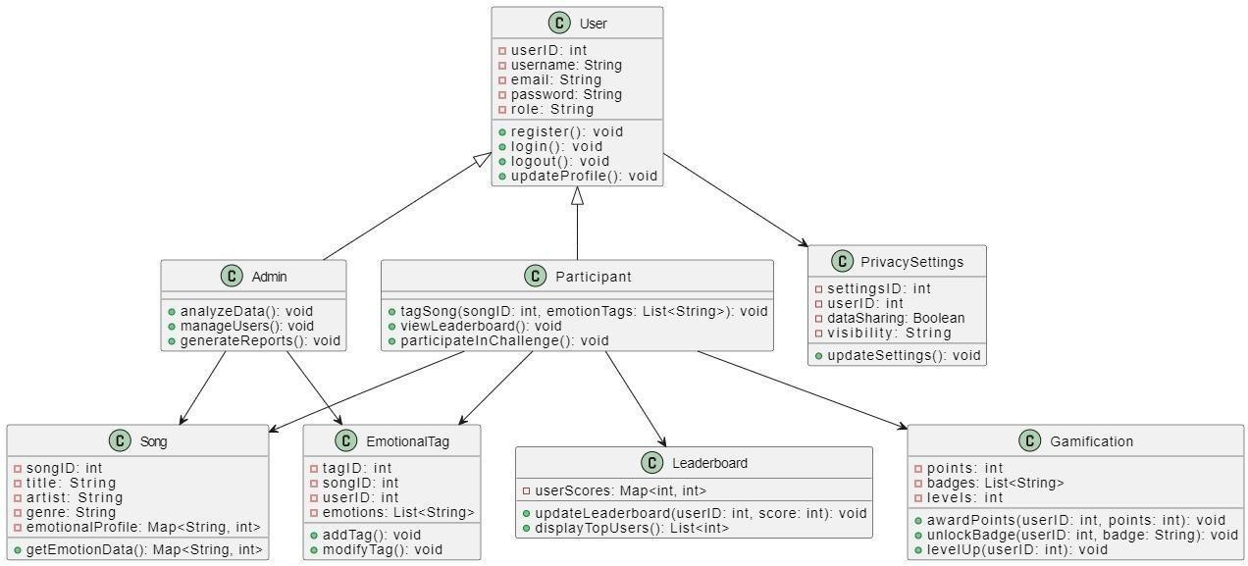

Slide 13
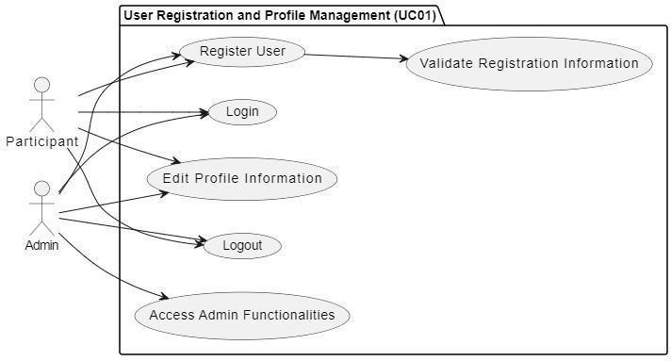
Figure 1 : User Registration and Profile Management

Slide 14
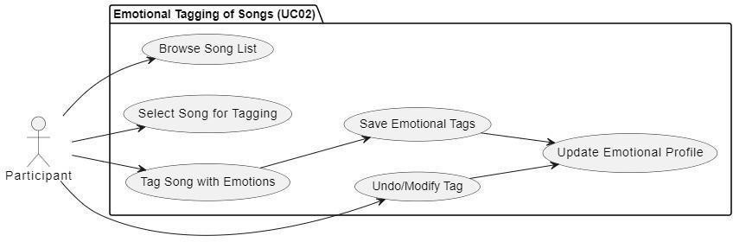
Figure 2: Emotional Tagging of Songs

Slide 15
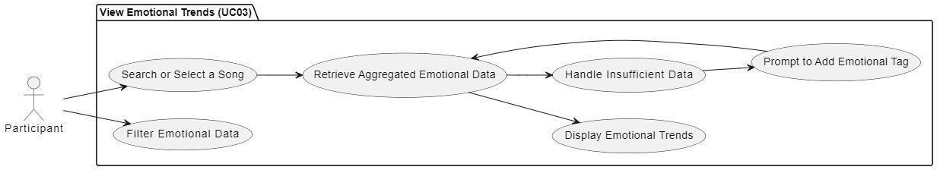
Figure 3: View Emotional Trends

Slide 16
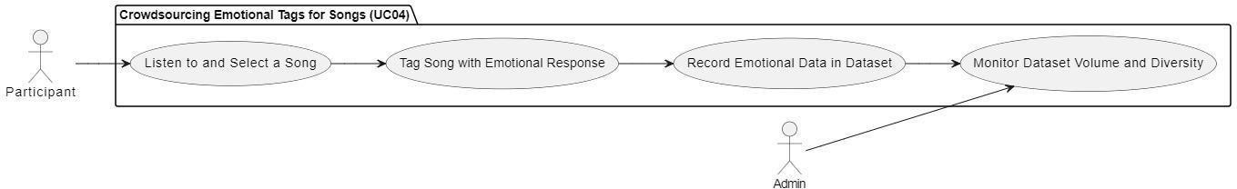
Figure 4 : Crowdsourcing Emotional Tags for Songs

Slide 17
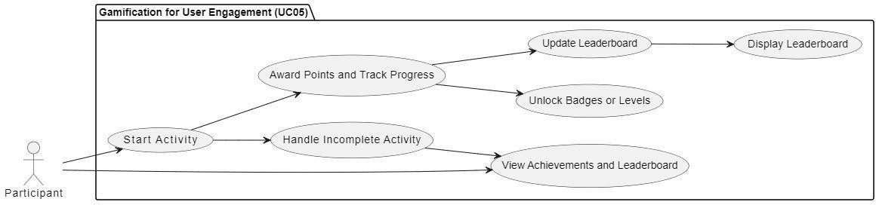
Figure 5: Gamification for User Engagement

Slide 18
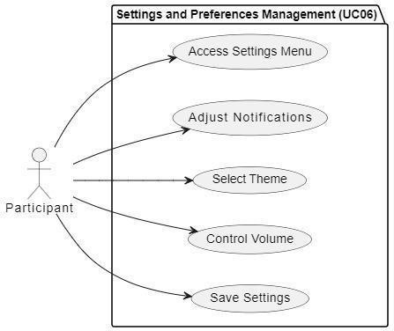
Figure 6: Settings and Preferences Management

Slide 19
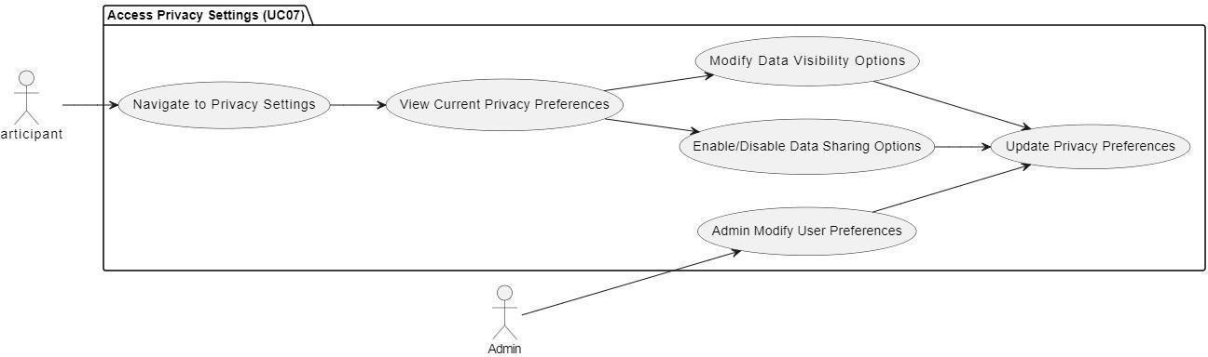
Figure 7: Access Privacy Settings

Slide 20
Figure 8: Song and Emotion Data Analysis

Slide 21
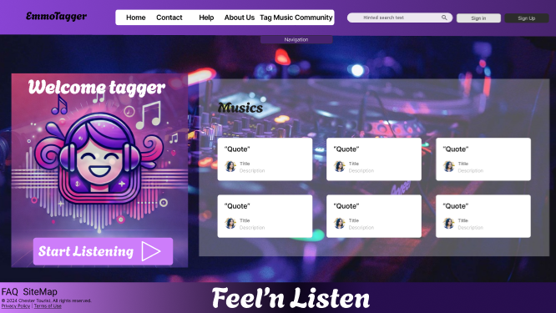
Home Page
The user interface designs for the EmoTagger project were created using Figma to provide a modern and user-friendly experience.
Supported by an attention-grabbing color palette and intuitive navigation elements, the design emphasizes user engagement. The dominant use of purple throughout the interface was a deliberate choice, as it conveys creativity and emotional depth, aligning perfectly with the project's theme of exploring the emotional impact of music.

Slide 22
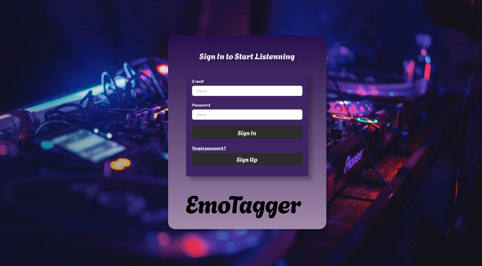
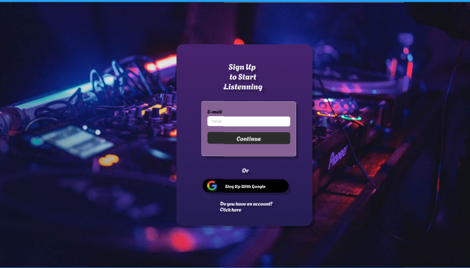
Register Page
Login Page

Slide 23
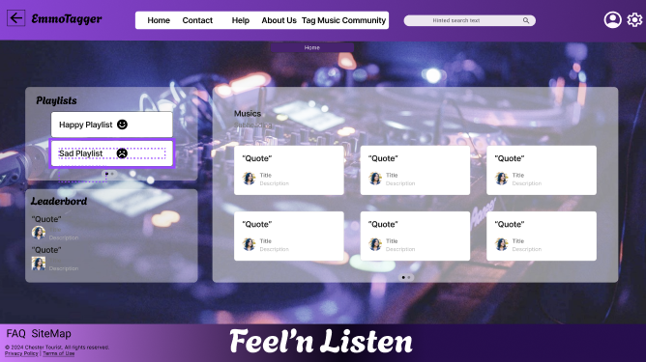
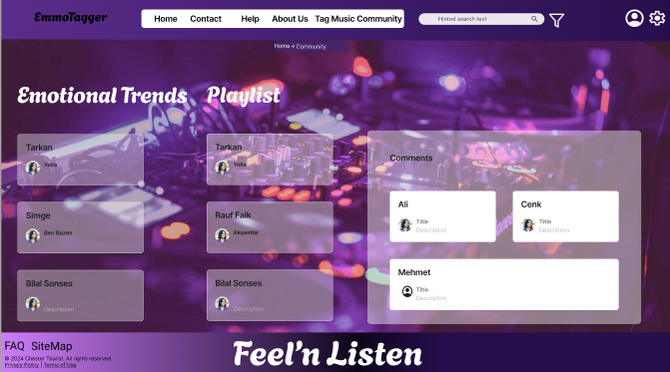
Home Page 2
Community

Slide 24
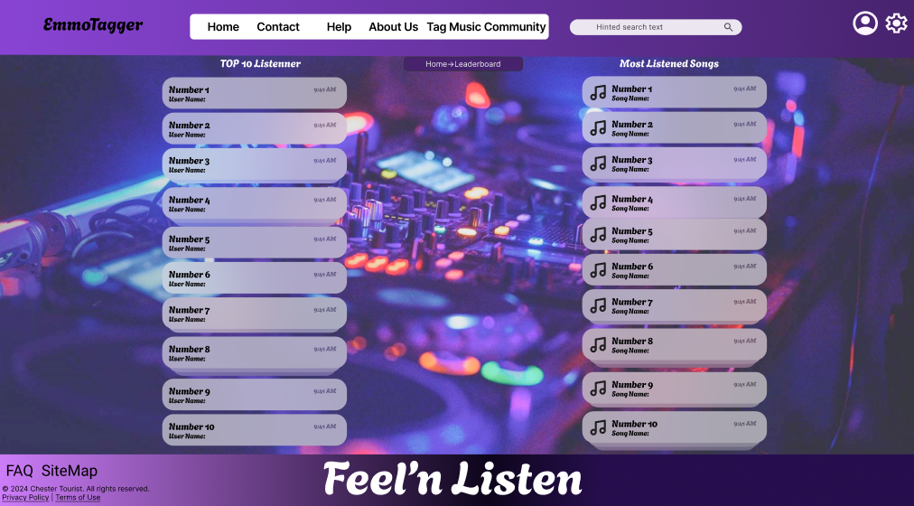
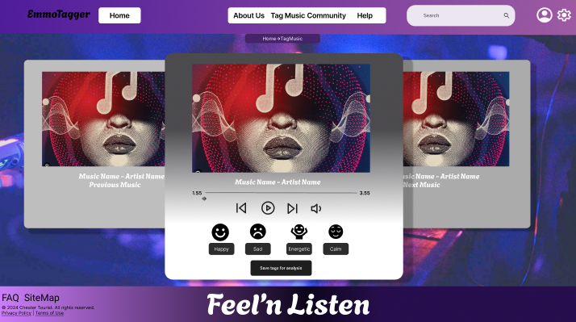
Gamification and Leaderboard
Emotional Tagging Interface

Slide 25
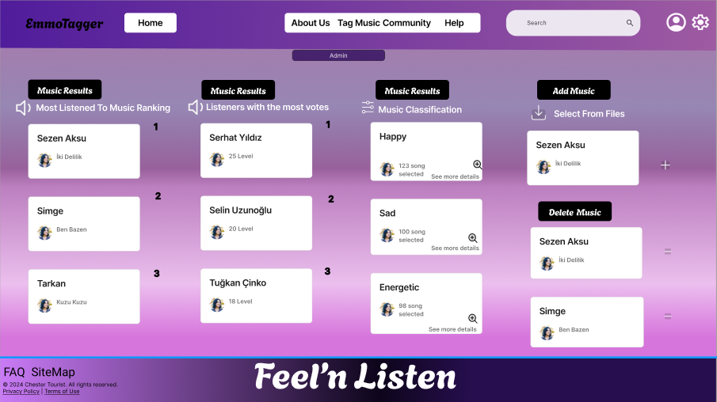
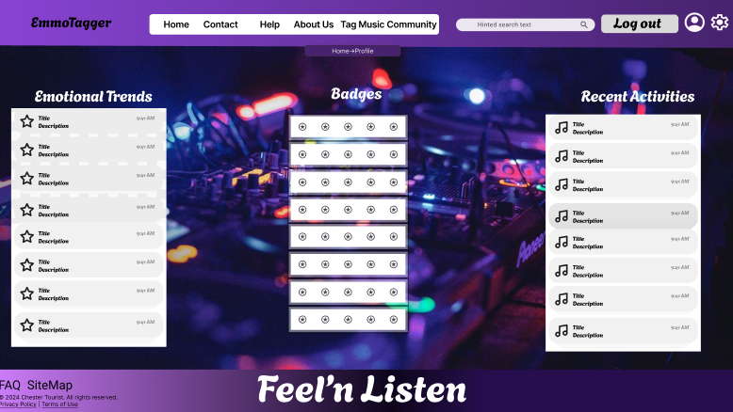
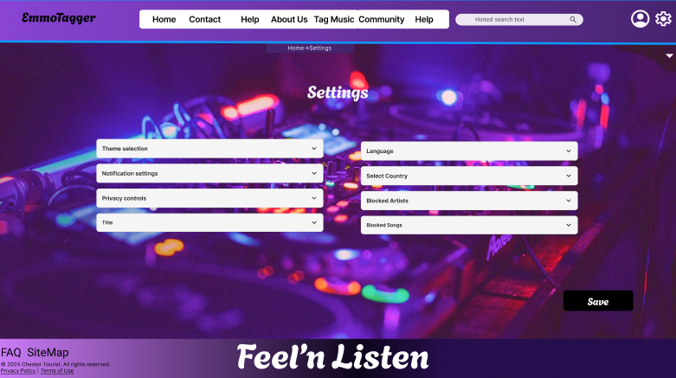
Admin Page
Profile Page
Settings

Slide 26





Our primary objective for the second semester is to implement the Emo Tagger project with maximum efficiency and make it available for use. Upon completing all requirements, we plan to undertake additional initiatives to integrate deep learning and artificial intelligence into our project.

Slide 27
WEB SITE: https://emotagger.com.tr
Our project is mentioned superficially on our website and documents are added. SSL certificate has been added so that the connection can be opened securely.

Slide 28

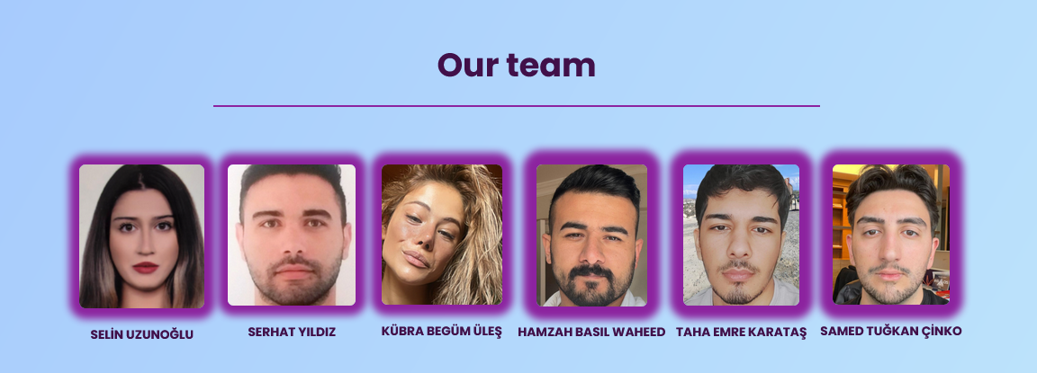


THANKS FOR LISTENING TO US

